Slide 1






Matlab accessing SPECCHIO
Andy Hueni¹
¹ Remote Sensing Laboratories, University of Zurich, Switzerland
SPECCHIO Programming Course
Zurich 2017
Page <number>

Slide 2
Agenda
Configuring your machine for SPECCHIO access from Matlab
Connecting to SPECCHIO
Selecting data
Load spectral data from database
Load metadata from database
Adding metadata
Inserting spectra and metadata from a file
    Creating a new campaign
    Creating a hierarchy
    Creating new attributes in the database
    Querying campaign and hierarchy IDs
    Inserting spectral data and metadata using a spectral file object
  Spatial Operations (SPECCHIO V3.3.0.0)
  Matlab GUI demonstration
  Resources: example code
  Data Selection: Auto-generated Code
Page <number>

Slide 3
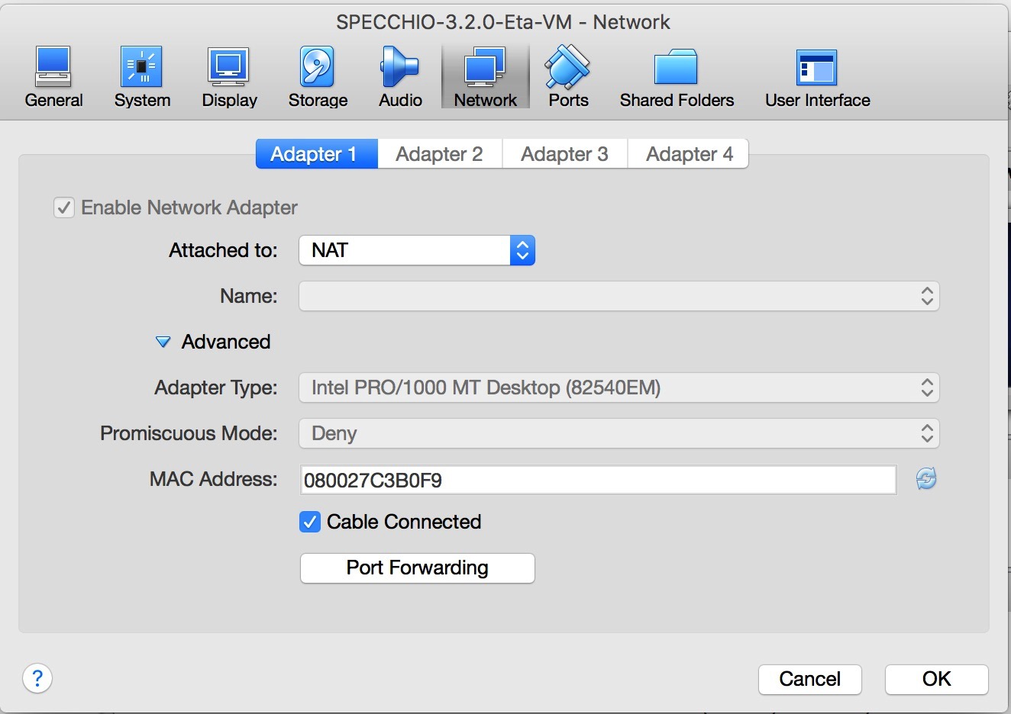
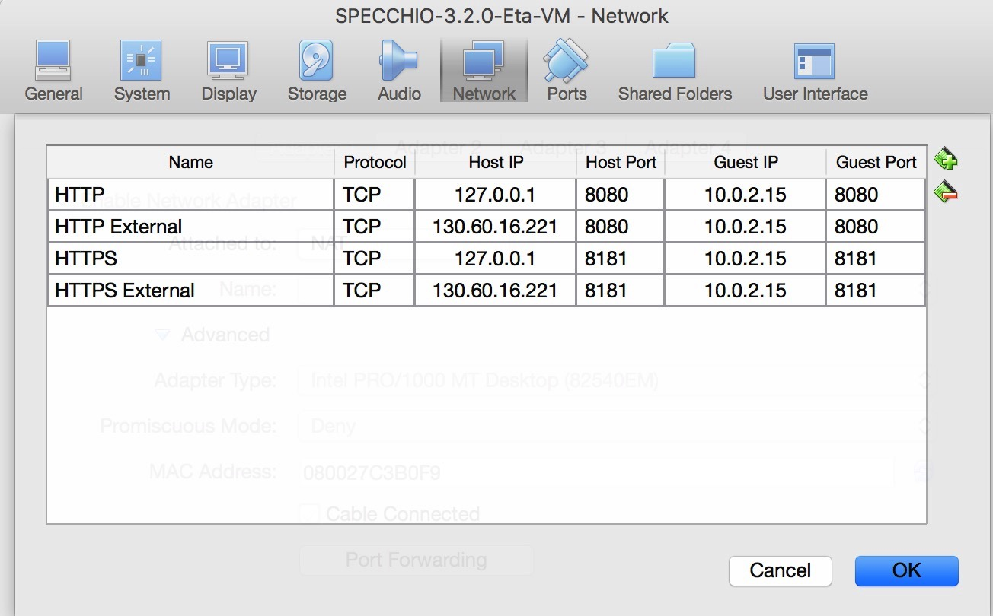
Making the SPECCHIO VM server accessible from the host machine
Generally, your VM should be preconfigured to support accessibility out of the box.
Open the ‘settings’ of your VM and select the ‘Network’ tab.
Add two entries in the ‘Port Forwarding’ table to map HTTPS and HTTP ports of the host to the VM
Page <number>

Slide 4
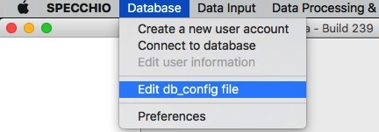
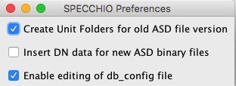
Install the SPECCHIO Client on your Host Machine
To access SPECCHIO from the host machine the SPECCHIO client must be installed on the host machine.
Download the SPECCHIO client from the SPECCHIO web page
(http://specchio.ch/app_download.php) or from GitHub.
Add an entry into the SPECCHIO client configuration file to access the SPECCHIO VM as admin user. In case the menu item is greyed out, enable it first in the SPECCHIO Preferences.
http, localhost, 8080, /specchio_service, sdb_admin, 5p3cch10, jdbc/specchio
Now try connecting to the SPECCHIO database from your host machine using the new account details you just added.
Page <number>

Slide 5
Connecting to SPECCHIO - Matlab
Create a new Matlab script, test each of the lines below as you enter them.
Add the path to the SPECCHIO jar files installed on your host machine (example given for MacOS): this not only defines where the SPECCHO classes are but also gives automatically access to the connection details stored in the db_config file.
% dynamic classpath setting
javaaddpath ({'/Applications/SPECCHIO/SPECCHIO.app/Contents/Java/specchio-client.jar', ...
'/Applications/SPECCHIO/SPECCHIO.app/Contents/Java/specchio-types.jar'});
Import the classes of the SPECCHIO client package:
import ch.specchio.client.*;
Create a client factory instance and get a list of all connection details:
cf = SPECCHIOClientFactory.getInstance();
db_descriptor_list = cf.getAllServerDescriptors();
Create client for the first entry in the database connection list:
specchio_client = cf.createClient(db_descriptor_list.get(0)); % zero indexed
If no error appears then you are connected successfully to the SPECCHIO database running in your SPECCHIO VM
Page <number>

Slide 6
Connecting to SPECCHIO - Matlab
If you want to see what server you just connected to, type:
db_descriptor_list.get(0)
Page <number>

Slide 7
Selecting data - Matlab
The SPECCHIO tutorial dataset contains some spectra that have a spatial position.
We are now going to select spectra based on their altitude above sea level. Our condition is that the altitude must be 50m or higher.
Import the query package:
import ch.specchio.queries.*;
Create a query object:
query = Query();
Get the attribute that we want to restrict:
attr = specchio_client.getAttributesNameHash().get('Altitude');
Create query condition for the altitude attribute and configure it:
cond = EAVQueryConditionObject(attr);
cond.setValue('50.0');
cond.setOperator('>=');
query.add_condition(cond);
Get spectrum ids that match the query:
ids = specchio_client.getSpectrumIdsMatchingQuery(query);
Page <number>

Slide 8
Selecting data - Matlab
Check how many spectra we found
ids.size()
List the spectrum ids:
ids.toArray
Add another condition to restrict the maximum altitude:
cond = EAVQueryConditionObject(attr);
cond.setValue('55.0');
cond.setOperator('<');
query.add_condition(cond);
Get spectrum ids that match the query
ids = specchio_client.getSpectrumIdsMatchingQuery(query);
Check the size of the ids variable again – there should be less spectra selected than before
Page <number>

Slide 9
Load spectral data from database - Matlab
Refer to the general presentation on SPECCHIO explaining the Spectral Space concept and the Space Factory; the following statements are using the implementation of these concepts.
Create spectral spaces and order the spectra by their acquisition time (note: this does not load the spectral vectors yet but only prepares the ‘containers’) :
spaces = specchio_client.getSpaces(ids, 'Acquisition Time');
Find out how many space we have received:
spaces.length()
Get the first space (note: the spaces are now a Matlab array and are therefore indexed starting at 1):
space = spaces(1);
The order of the ids may have changed because the vectors in the space are ordered by their Acquisition Time; therefore get the ids in their correct sequence to match the vector sequence:
ids = space.getSpectrumIds(); % get them sorted by 'Acquisition Time’
Load the spectral data from the database into the space:
space = specchio_client.loadSpace(space);
Page <number>

Slide 10
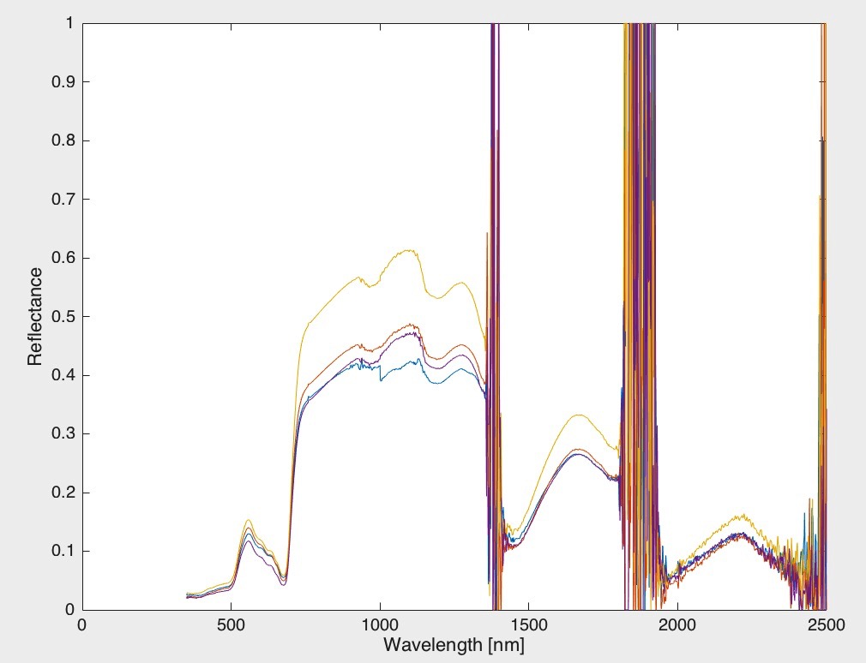
Load spectral data from database - Matlab
Get the spectral vectors as Matlab array:
vectors = space.getVectorsAsArray();
Get the wavelengths are a vector:
wvl = space.getAverageWavelengths();
Get the unit of the spectra:
unit = char(space.getMeasurementUnit.getUnitName);
Plot the spectra:
figure
plot(wvl, vectors)
xlabel('Wavelength [nm]')
ylabel(unit)
ylim([0 1])
Page <number>

Slide 11
Load metadata from database - Matlab
Get the file names of the spectra held by the current space:
filenames_ = specchio_client.getMetaparameterValues(ids, 'File Name');
Create legend with filenames and add it to plot:
for i=1:size(filenames_)
legend_str{i} = filenames_.get(i-1);
end
legend (legend_str)
Get lat/lon as vectors and plot them:
lat = specchio_client.getMetaparameterValues(ids, 'Latitude').get_as_double_array();
lon = specchio_client.getMetaparameterValues(ids, 'Longitude').get_as_double_array();
figure
plot(lon, lat, 'o’)
Page <number>

Slide 12
Adding metadata - Matlab
New metadata can be added easily to existing spectral records; assignment of the same value can be done to multiple spectra at once. Let us assume that we want to add a proper species name to all blackfern spectra. All these spectra have been given a filename of bfern.XXX.
In a first step we will select all spectra with that filename to get all spectrum ids, then we will add the Common Name of this plant.
Get all ids that have a filename starting with bfern (note that the % character is the matching wildcard for one or more characters; as it is a special character in Matlab, one must use two % in a row):
query = Query();
attr = specchio_client.getAttributesNameHash().get('File Name');
cond = EAVQueryConditionObject(attr);
cond.setValue('bfern.%%');
cond.setOperator('like');
query.add_condition(cond);
Get spectrum ids that match the query:
ids = specchio_client.getSpectrumIdsMatchingQuery(query);
Page <number>

Slide 13
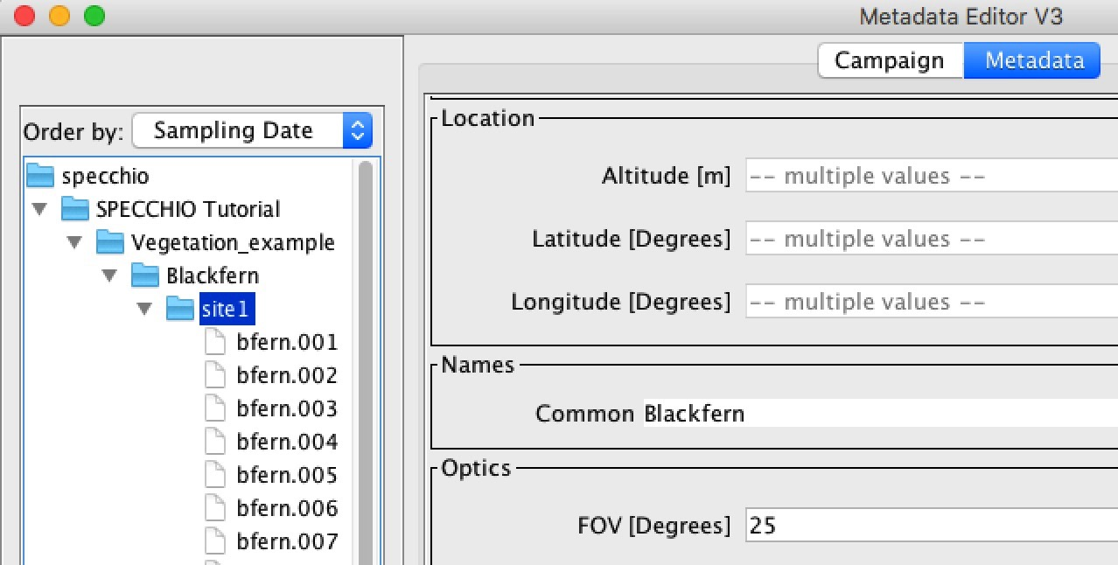
Adding metadata - Matlab
Create new metaparameter and attach it to the selected spectra:
import ch.specchio.types.*
common_name_attr = specchio_client.getAttributesNameHash().get('Common');
e = MetaParameter.newInstance(common_name_attr);
e.setValue('Blackfern');
specchio_client.updateEavMetadata(e, ids);
Open the metadata editor and check the bfern spectra: they should now all have a ‘Common’ Name Field filled with ‘Blackfern’.
Page <number>

Slide 14
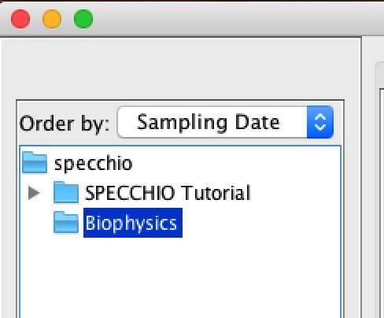
Creating a new campaign - Matlab
Create a new campaign programmatically:
c = SpecchioCampaign();
c.setName('Biophysics (Matlab)');
c_id = specchio_client.insertCampaign(c)
c.setId(c_id); % store the campaign id in our campaign object: required below ...
The identifier of the new campaign is stored in the c_id variable
Open the metadata editor and check the available campaigns, you should see your new campaign in the browser:
Page <number>

Slide 15
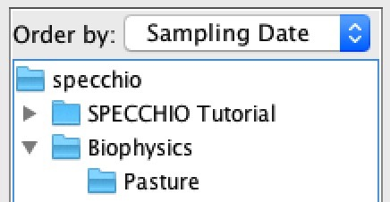
Creating a hierarchy - Matlab
In this step we add a hierarchy to our new campaign (we could also choose to have no hierarchy and list all spectra just directly under the campaign, but hierarchies keep things tidy):
hierarchy_id = specchio_client.getSubHierarchyId(c, 'Pasture', 0);
The zero argument signifies that the hierarchy has no parent hierarchy, i.e. it is directly connected to the campaign
Open the metadata editor and check the available campaigns, you should see your new campaign with a new hierarchy added in the browser:
Page <number>

Slide 16
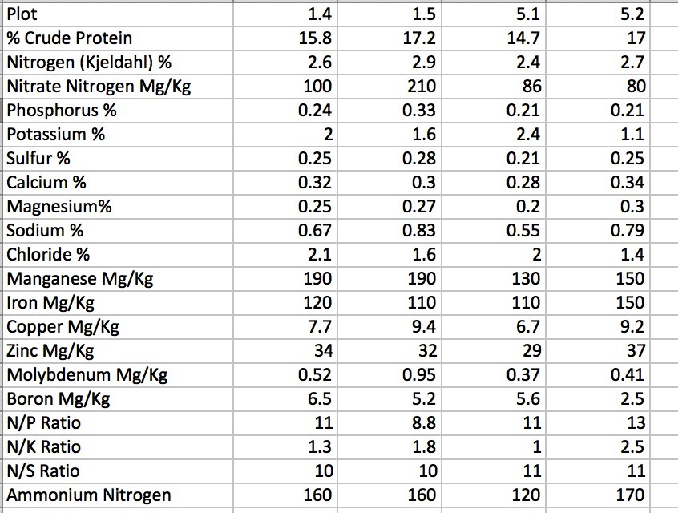
Input Files of this Exercise
We have received to files¹ in CSV format that contain spectral data and metadata (spectra.csv and metadata.csv). Open the files in Excel and have a look at the content.
Quite a lot of parameters have been
established by laboratory measurements
We could of course add all of them, but
for simplicity, lets add ‘Plot’ which is a plot
number, Nitrate Nitrogen and Phosphorus.
If you check the existing metaparameters
in SPECCHIO, you will notice that
pretty much all of these parameters do not
yet exist.
We will use the ‘Target Id’ for the plot
number, but we need to insert new
attributes for Nitrate Nitrogen and
Phosphorus
¹ Kindly contributed by L. Suarez, RMIT, Melbourne, Australia
Page <number>

Slide 17
Adding new Attributes
New attributes must be defined in the database using SQL. Our statements for this are:
﻿ INSERT INTO `specchio`.`attribute`(`name`, `category_id`, `default_storage_field`, `default_unit_id`, `description`) VALUES ('Nitrate Nitrogen', (select category_id from `specchio`.category where name = 'Vegetation Biophysical Variables'), 'double_val', (select unit_id from `specchio`.unit where short_name = ’﻿
'), 'Nitrate');
﻿INSERT INTO `specchio`.`attribute`(`name`, `category_id`, `default_storage_field`, `default_unit_id`, `description`) VALUES ('Phosphorus', (select category_id from `specchio`.category where name = 'Vegetation Biophysical Variables'), 'double_val', (select unit_id from `specchio`.unit where name = 'Percent'), 'Phosphorus');
Note: to select ‘Percent’ we use the ‘name’ field of the unit table, finding it via the short_name would require escaping the % character, which is a wildcard in SQL.
Page <number>

Slide 18
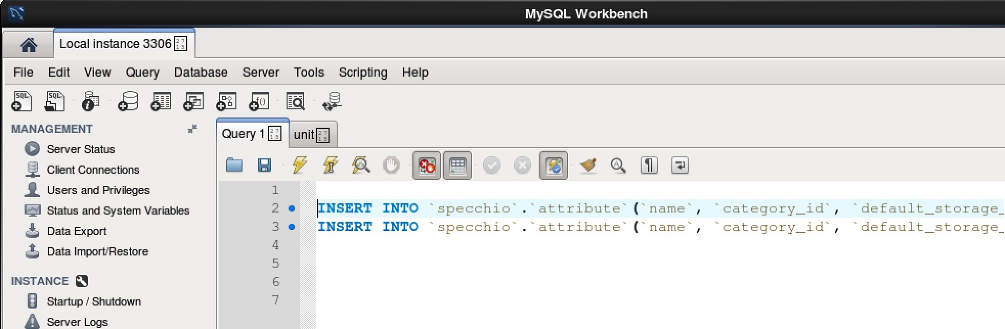
Adding new Attributes
Open your virtual machine as root user (password is ‘reverse’)
Open the MySQL Workbench (Applications/Programming/MySQL Workbench)
Copy the two insert statements into the Query tab and press the ‘Run’ button
Page <number>

Slide 19
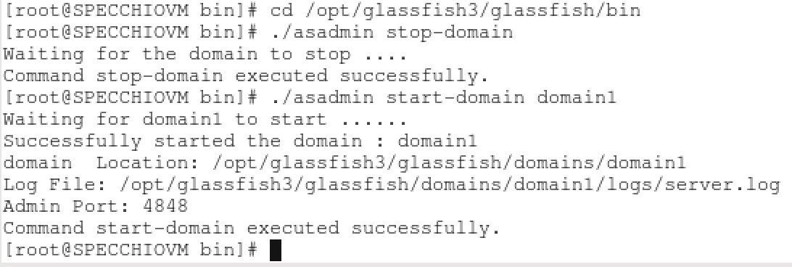
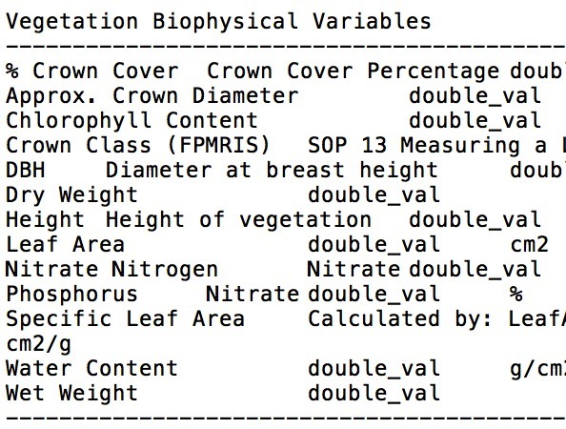
Adding new Attributes
To make the newly added attributes available a restart of the SPECCHIO server is required.
You could simply close and open the VM; another solution is to stop and start the server using the command line:
  Open a terminal in the VM and enter the following commands:
  cd /opt/glassfish3/glassfish/bin
  ./asadmin stop-domain
  ./asadmin start-domain domain1
Reconnect your SPECCHIO client to the database and the new attributes are now available
Page <number>

Slide 20
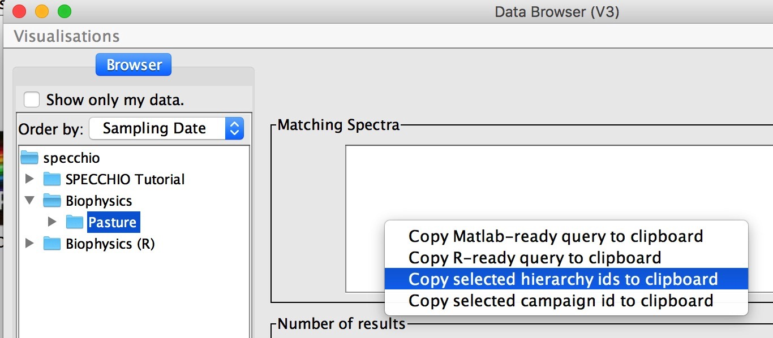
Getting Campaign and Hierarchy IDs
If you had to close you programming environment, then you may have forgotten the IDs of your new campaign and the hierarchy you just created.
They can be easily retrieved using the SPECCHIO Query Browser: select the campaign or the hierarchy you require, then select the appropriate action from the pop-up menu in the ‘Matching Spectra’ text field:
Page <number>

Slide 21
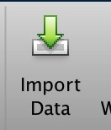
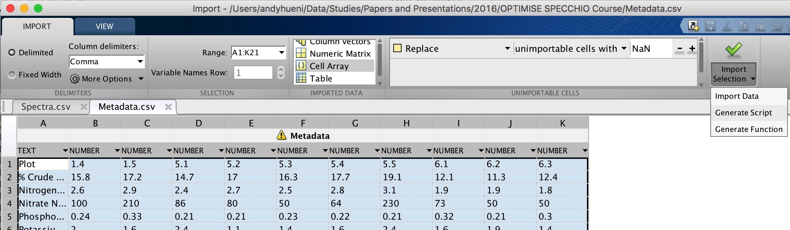
Reading and Processing the Input Files - Matlab
Load the spectral CSV and the metadata CSV files into Matlab:
% load spectral file
filepath = '/Users/andyhueni/Data/Studies/Papers and Presentations/2016/OPTIMISE SPECCHIO Course';
filename = 'Spectra.csv’;
wvls_and_spectra = csvread([filepath filesep filename]);
wvls = wvls_and_spectra(:,1);
spectra = wvls_and_spectra(:,2:end);
To load the metadata file, the easiest is to use the ‘Import
Data‘ function in Matlab, telling it to create a cell array and create the code as well:
Page <number>

Slide 22
Reading and Processing the Input Files - Matlab
There should now be three new variables in the Matlab workspace:
wvls, spectra , metadata
The following code generates a spectral file object, fills the spectral data into a Java Array and the metadata into a metadata object. The spectral file object is then stored in the database under the campaign and hierarchy we created.
%% create spectral file object and fill in some info …
s = ch.specchio.types.SpectralFile;
s.setNumberOfSpectra(size(spectra,2));
s.setPath(filepath);
s.setFilename(filename);
s.setCompany('ASD');
% set campaign and hierarchy to store in
s.setHierarchyId(hierarchy_id);
s.setCampaignId(c_id);
% create array for spectral data
spectra_array = javaArray('java.lang.Float',size(spectra,2),length(wvls));
% create wvls array and fill it
java_wvls = javaArray('java.lang.Float',length(wvls));
for w=1:length(wvls)
java_wvls(w) = java.lang.Float(wvls(w));
end
Page <number>

Slide 23
% add spectral data and metadata
for i=1:size(spectra,2)
% fill vector in array
vector = spectra(:,i);
for w=1:length(wvls)
spectra_array(i,w) = java.lang.Float(vector(w));
end
% add wvls (done for each spectrum individually)
s.addWvls(java_wvls);
% add filename: here we add an automatic number to make them distinct
s.addSpectrumFilename([filename ' ' num2str(i)]);
% add plot number
smd = ch.specchio.types.Metadata();
mp = MetaParameter.newInstance(specchio_client.getAttributesNameHash().get('Target ID'));
mp.setValue(num2str(metadata{1,i+1})); % meta values start in the 2 column, Plot is in the 1 row
smd.addEntry(mp);
% add Nitrate
mp = MetaParameter.newInstance(specchio_client.getAttributesNameHash().get('Nitrate Nitrogen'));
mp.setValue(metadata{4,i+1}); % meta values start in the 2 column
smd.addEntry(mp);
% add Phosphorus
mp = MetaParameter.newInstance(specchio_client.getAttributesNameHash().get('Phosphorus'));
mp.setValue(metadata{5,i+1}); % meta values start in the 2 column
smd.addEntry(mp);
s.addEavMetadata(smd); % add the metadata structure to the spectral file object
end
s.setMeasurements(spectra_array); % set the measurement array (all spectral data)
specchio_client.insertSpectralFile(s);
Page <number>

Slide 24
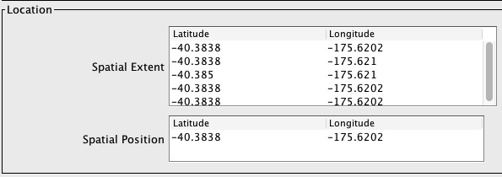
Spatial Operations (SPECCHIO V3.3.0.0)
Spatial operations are supported from SPECCHIO V3.3.0.0 onwards, basing on the MySQL spatial extension (Note: MySQL may not have the best spatial support but at this point we have no resources to port to e.g. PostGIS).
How spatial are handled in SPECCHIO:
Supports point, polyline and polygon geometries. These are implemented as new attributes in the SPECCHIO metadata system: 'Spatial Position’, 'Spatial Transect' and 'Spatial Extent’
Supports spatial searches by polygon
New entry fields and report fields for spatial data in the Metadata Editor and Spectrum Report:
Page <number>

Slide 25
Inserting Spatial Metadata: select spectra to be updated
import ch.specchio.types.*;
% Query pasted from SPECCHIO Query builder and manually edited to just set conditions for the File Name attribute:
% >>>>>>>>>>>>>>>>>>>>>>
query = Query('spectrum');
query.setQueryType(Query.SELECT_QUERY);
query.addColumn('spectrum_id')
cond = EAVQueryConditionObject('eav', 'spectrum_x_eav', 'File Name', 'string_val');
cond.setValue('%%cabbage%%'); % select spectra with a filename like 'cabbage'
cond.setOperator('like');
query.add_condition(cond);
ids = specchio_client.getSpectrumIdsMatchingQuery(query);
%<<<<<<<<<<<<<<<<<<<<<<<<<<<
Page <number>

Slide 26
Inserting Spatial Metadata: spatial position
%% Spatial Position insert for all selected spectra
% create new coordinate object point: (lat, lon)
coord = Point2D(-40.3838, -175.6202);
% create point metaparameter to add to spectra
spatial_point_attribute = specchio_client.getAttributesNameHash().get('Spatial Position');
mp = MetaParameter.newInstance(spatial_point_attribute);
mp.setValue(coord);
% insert metaparameter
specchio_client.updateEavMetadata(mp, ids);
% see how the point is represented in MySQL syntax
disp(mp.getEAVValue());
Page <number>

Slide 27
Inserting Spatial Metadata: spatial extent
%% create a polygon and add to spectra
% create list of coordinates to define polygon (polygon gets closed
% automatically by SPECCHIO before insert)
coords = java.util.ArrayList();
coord = Point2D(-40.3838, -175.6202);
coords.add(coord);
coord = Point2D(-40.3838, -175.6210);
coords.add(coord);
coord = Point2D(-40.3850, -175.6210);
coords.add(coord);
coord = Point2D(-40.3838, -175.6202);
coords.add(coord);
% create point metaparameter to add to spectra
spatial_extent_attribute = specchio_client.getAttributesNameHash().get('Spatial Extent');
mp = MetaParameter.newInstance(spatial_extent_attribute);
mp.setValue(coords);
% insert metaparameter
specchio_client.updateEavMetadata(mp, ids);
% see how the point is represented in MySQL syntax
disp(mp.getEAVValue());
Page <number>

Slide 28
Spatial Selection
% Query pasted from SPECCHIO Query builder and manually edited to just set conditions for the File Name attribute:
% >>>>>>>>>>>>>>>>>>>>>>
query = Query('spectrum');
query.setQueryType(Query.SELECT_QUERY);
query.addColumn('spectrum_id')
% select spectra with spatial position inside polygon
cond = EAVQueryConditionObject('eav', 'spectrum_x_eav', 'Spatial Position', 'spatial_val');
cond.setValue('ST_GeomFromText(''Polygon((-40 -175.6,-40 -176.8,-41.2 -176.8,-41.2 -176.8,-40 -175.6))'')');
cond.setOperator('MBRContains'); % MySQL spatial operator
query.add_condition(cond);
ids = specchio_client.getSpectrumIdsMatchingQuery(query);
%<<<<<<<<<<<<<<<<<<<<<<<<<<<
disp(ids.size());
Page <number>

Slide 29

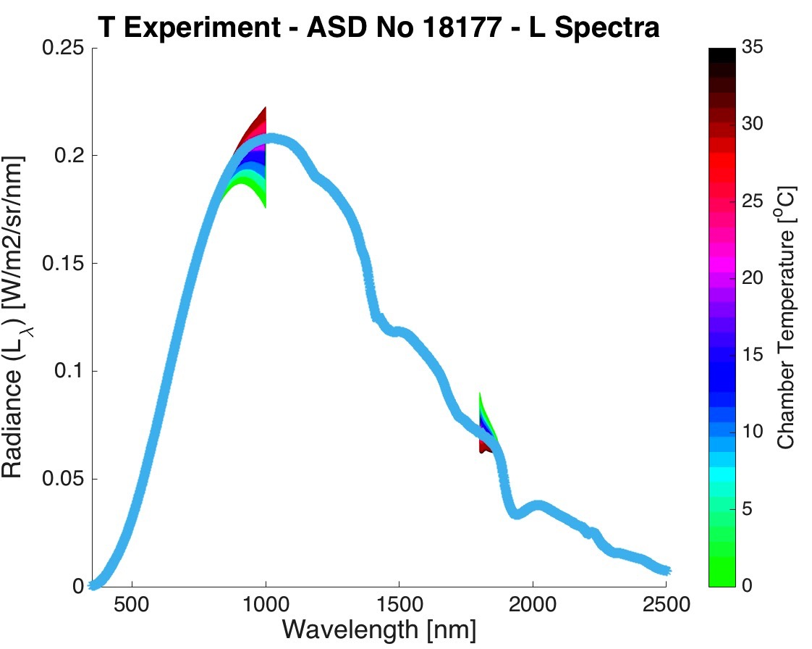
General Processing Workflow
Data Analysis: easiest in Matlab/R
Meta
Files
Data Augmentation: add metadata to spectra: Matlab/R are the most flexible solutions. SPECCHIO GUI can also work.
Spectral
Files
Insert
Select/Insert
Data ingest:
Either via SPECCHIO GUI,
or if no reader exists, use our own implementation in Matlab or R
SPECCHIO Server
SPECCHIO
DB
Page <number>

Slide 30
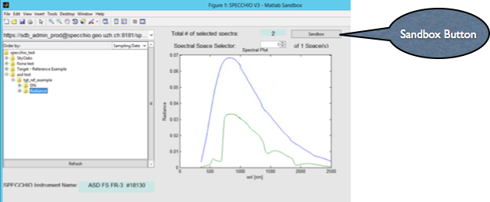
Matlab Interactive GUI Sandbox
Page <number>

Slide 31
Sandbox function
function SPECCHIO_Sandbox(hObject, EventData)
fh = ancestor(hObject.hghandle, 'figure');
user_data = get(fh, 'UserData');
%% Do whatever needs doing with the data ....
% e.g. get the mean:
avg_spectrum = mean(user_data.current_spectra.vectors);
% do a plot
figure
plot(user_data.current_spectra.wvl, user_data.current_spectra.vectors);
end

Slide 32
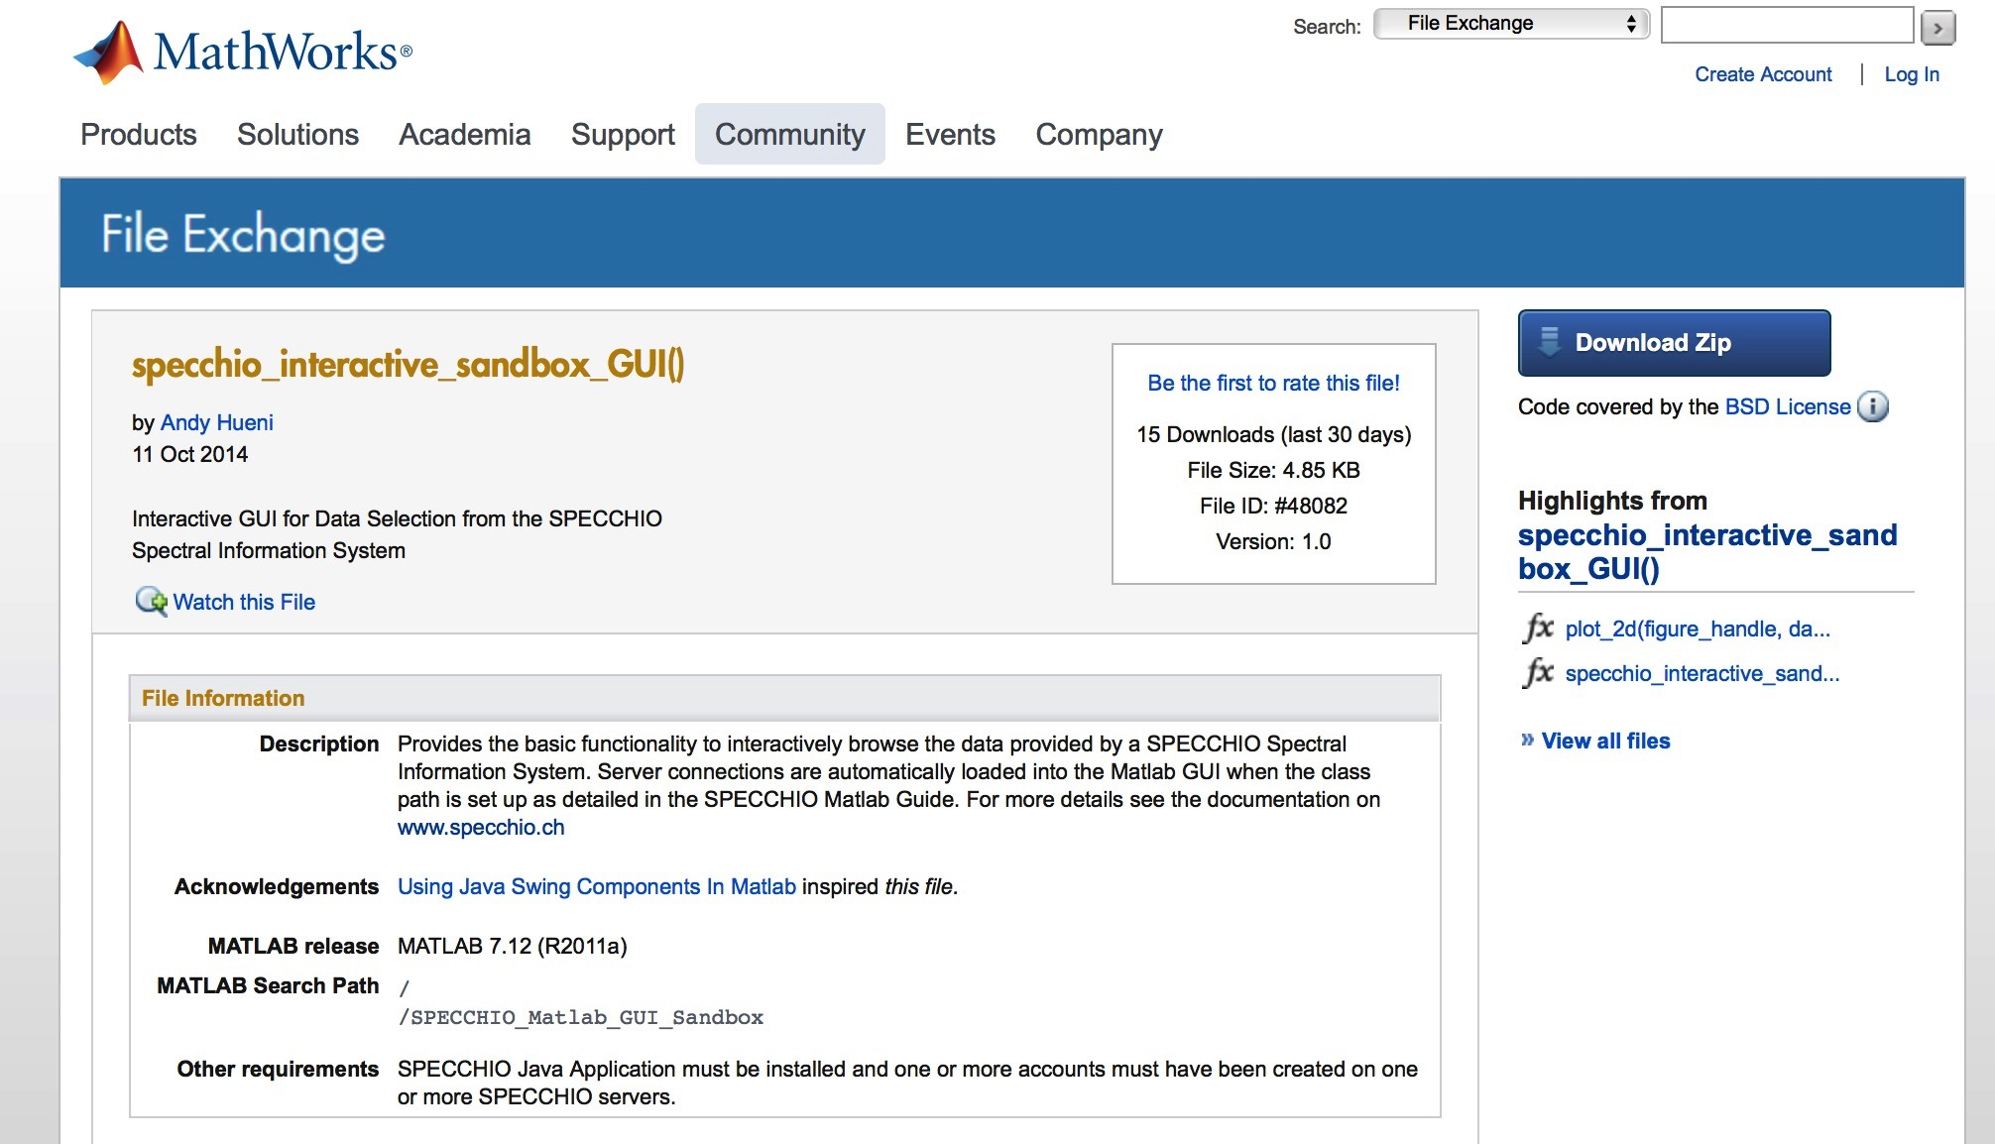
Matlab Central
Page <number>

Slide 33
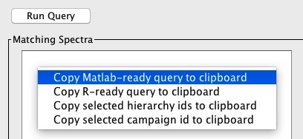
Data Selection: Auto-generated Code from SPECCHIO Query Builder GUI
query = Query('spectrum');
query.setQueryType(Query.SELECT_QUERY);
query.addColumn('spectrum_id')
cond = EAVQueryConditionObject('eav', 'spectrum_x_eav', 'Instrument Temperature', 'double_val');
cond.setValue('15.0');
cond.setOperator('>=');
query.add_condition(cond);
ids = specchio_client.getSpectrumIdsMatchingQuery(query);
Page <number>

Slide 34
Participants Feedback
How was the course?
What should be added or changed?
Was the course too short, too long, just right?
What programming user help would you like to see?
Please send me your feedback by email before end of course
ahueni@geo.uzh.ch
Some of our ideas what could be done:
Have a project with input data and analysis goals to work through as a team
Exercise on program structuring and where to use which SPECCHIO function
Page <number>

Slide 35




Thank you for your attention!
For more information on the current version of SPECCHIO see: www.specchio.ch
https://twitter.com/SPECCHIO_DB
Page <number>

